Slide 1
Digital Portfolio
STUDENT NAME:KAVIPRIYA.P
REGISTER NO AND NMID:asbru3j2428b0228 AND 5AE2572447B71CA919D48E7B6F3BDD33
DEPARTMENT: B.SC COMPUTER SCIENCE WITH DATA ANALYTICS
COLLEGE: TIRUPPUR KUMARAN COLLEGE FOR WOMEN/BHARATHIAR UNIVERSITY

Slide 2
PROJECT TITLE
DATA ANALYTICS

Slide 3


AGENDA
Problem Statement
Project Overview
End Users
Tools and Technologies
Portfolio design and Layout
Features and Functionality
Results and Screenshots
Conclusion
Github Link
3/21/2024 Annual Review

Slide 4

PROBLEM STATEMENT
A problem statement in data analytics is a clear, concise description of the issue or challenge that needs to be solved using data. It defines the what, why, and how of the problem, helping analysts focus on the objective, scope, and expected outcome.

Slide 5

PROJECT OVERVIEW
A project overview in data analytics is a short summary that explains what your project is about, why it matters, and how you approached solving the problem using data. It usually comes after the problem statement and serves as an introduction for readers, recruiters, or stakeholders.

Slide 6

WHO ARE THE END USERS?
In data analytics, the end users are the people who consume the insights, reports, dashboards, or predictions generated from data. They rely on analytics results to make better decisions, but they are not necessarily the ones doing the technical analysis.

Slide 7

TOOLS AND TECHNIQUES
Tools: Python, R, SQL, Excel, Tableau, Power BI, Hadoop, Spark Techniques: Cleaning, EDA, Visualization, Regression, ML, Forecasting

Slide 8
POTFOLIO DESIGN AND LAYOUT
1. Cover / Bio 2. Projects (Problem → Data → Analysis → Insights) 3. Tools & Skills 4. Contact / GitHub
8

Slide 9
FEATURES AND FUNCTIONALITY
Features & Functionality: Collect, clean, visualize data; find patterns; predict; support decisions.

Slide 10
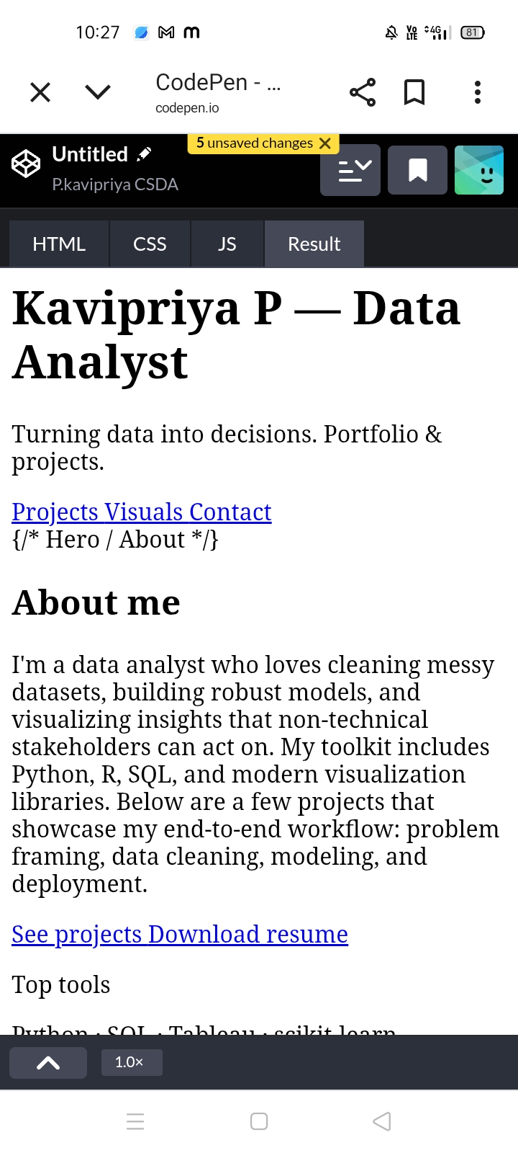
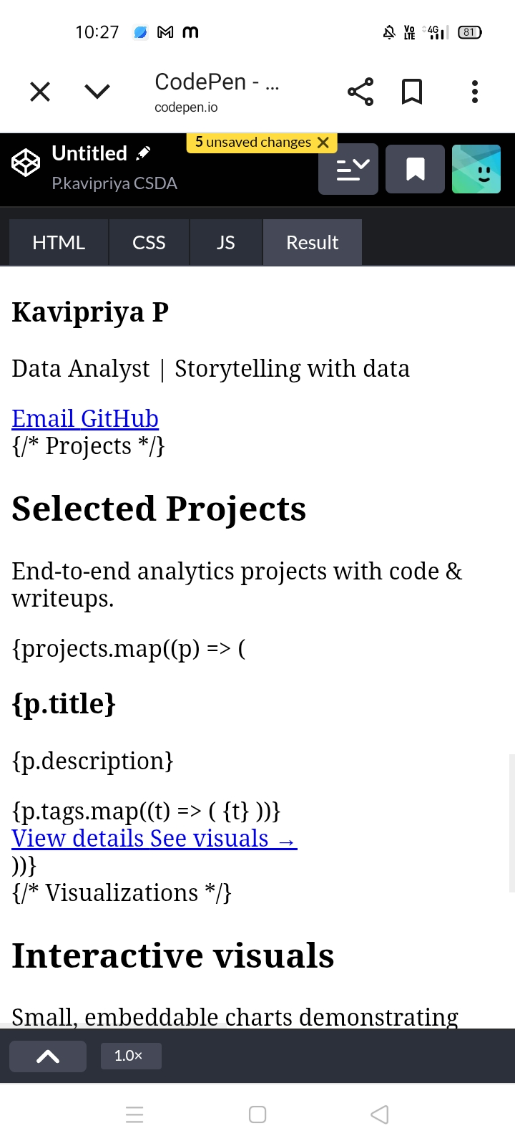

RESULTS AND SCREENSHOTS
3/21/2024 Annual Review
10

Slide 11
CONCLUSION
Data analytics turns raw data into insights, helping businesses and organizations make informed decisions, identify trends, and improve performance.
11

